Slide 1
Crowdsourcing DDI Development: New Features from the CED²AR Project
Benjamin Perry, Cornell University

Slide 2
What is CED²AR?
Part of the NSF Census Research Network (NCRN) (Grant #1131848)
Lightweight, Data Documentation Initiative (DDI) driven web application
Enables search, browsing and editing across codebooks
Provides an open API for developers
Live example at demo.ncrn.cornell.edu
Notes:
-Part of the NSF Census Research Network
-The original grant aimed facilitate the creation of metadata from within the federal statistical system, in order to better document confidential datasets
-Lightweight, DDI driven web application driven by DDI 2.5
-Allows users to search and browse across DDI-C files with a focus on variables
-Provides an open API for developers, and designed for reuse

Slide 3
Initial Focus
Emphasis on collaborative editing (small set of users)
Online editor
Versioned and tracked metadata through Git
Tied into external authentication frameworks
Notes:
-Added web based DDI editor to CED2AR
-Implemented a prototype that incorporated the Git to version metadata
-Build a framework to support external authentication providers
This allowed for small teams to collaboratively curate DDI metadata for free

Slide 4
Now
Support crowdsourced DDI curation through CED²AR
Accommodating more users
Allow for application specific customization
Create incentives and guidance for users
Abstract technical barriers
Notes:
In the past few month, we expanded on that prototype,
Our goal was to allow crowdsourced DDI curation through ced2ar
-This involved scaling a system that was design for small teams, into a larger, more distributed solution
-Accommodating more users, and their metadata
-Allow for users to customize their deployment of ced2ar
-Create incentives and guidance for users
-Often researchers who need DDI don’t have the technical expertise to craft it
-At the same time tools can be equally as intimidating. Accommodating users of all skillset is a must.

Slide 5
Starting point here
Initial metadata (DDI) has been created and ingested into a CED²AR instance
Metadata may be
Incomplete (valid DDI but empty or non-informative fields)
Lacking user feedback (on value or constraints of variables)
Assumption:
Archivist is not the only specialist on a particular dataset
Users collectively have information that is not initially included in metadata
Notes:
Stats code
-mostly SAS, Stata, some SPSS and R
Our team converted into XML metadata
-This metadata is often very sparse and lacks detailed documentation such as labels, citations and descriptions
The missing metadata is then edited using CED2AR
Archivist uploads partially complete DDI

Slide 6
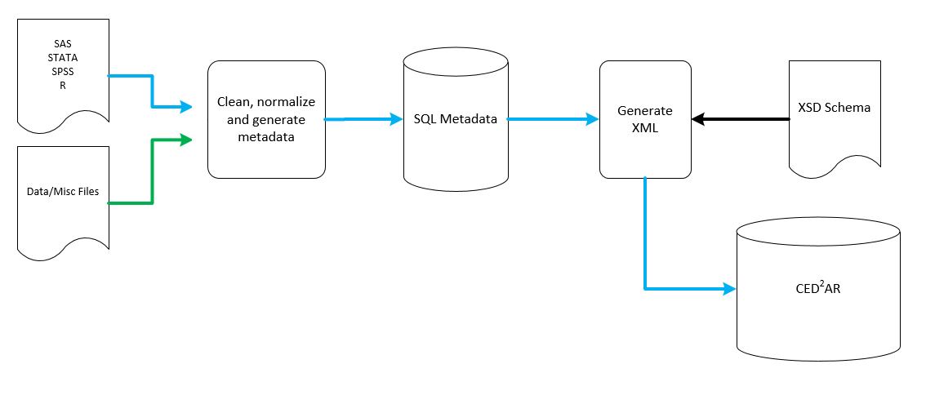
Ingest Workflow
Notes:
Our conversion software ingests
-data files
-stats code
All stats code is converted into SAS
Afterward we run the SAS code over the data to generate summary statics, and generate metadata in a relational database
A second software process then serializes the relational database into an XML format, using an XSD schema file.
-The advantage of this is we generate any format of DDI or other similar XML
CED2AR will then run off that generate DDI

Slide 7
User Workflow
User searches through CED²AR or external search engine
User discovers data relevant to their query
User can choose to contribute structured or unstructured documentation for datasets
No DDI knowledge required – user documents on fields, without needing to know how that fits into a particular metadata structure
May involve creating links (provenance) to other datasets
Notes:
-Entry points into CED2AR vary
--Search engines
--Looking for a specific codebook
--Starting from home page
-Searching cross codebook allows users to discover new datasets with similar information
-If a user sees incomplete metadata, has a question or wants to contribute additional information, CED2AR provides a mechanism for that

Slide 8
Attracting Users
Search engine optimization enhancements to DDI
Exposing community contributions
Retaining Users
Flexible authentication
Easy to use editor
Metadata scoring
Tracking and identifying community contributions
Notes:
Our key focus was to build mechanism that attracted more external users. We did this
-SEO
-Several forms of authentication -Designed around usability – especially considering that we’re targeting non-native DDI users
-Metadata score
-New tools to track communities contributions

Slide 9
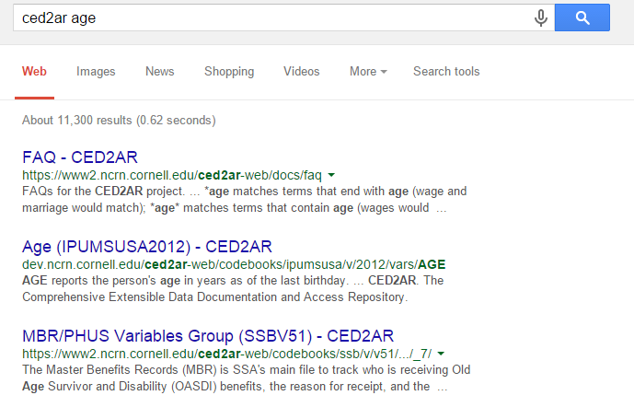
Search Engine Optimization
Expanding the interoperability of DDI
Notes:
Rich Snippet
-Use schema.org and creates a crosswalk to DDI

Slide 10

Authentication
Support OpenID and OAuth2
Currently using Google with OAuth2
Developing connectors to work with additional providers – currently working on ORCID
CED²AR handles identity management
Notes:
-CED2AR has the framework to OpenID and OAuth
-Currently, we are using Google with OAuth as a provider
-Identity management is defined within CED2AR. This includes permissions, roles, local user information, etc.

Slide 11
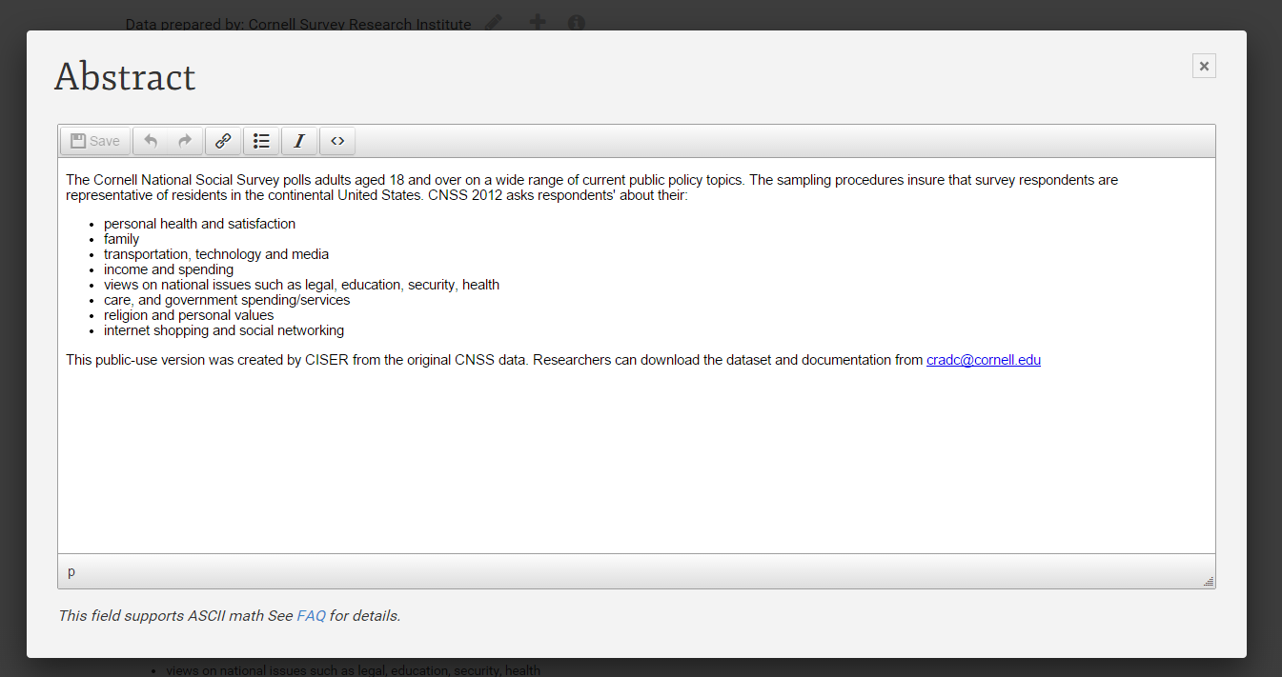
Editing
Automatic validation, and editor for rich content

Slide 12
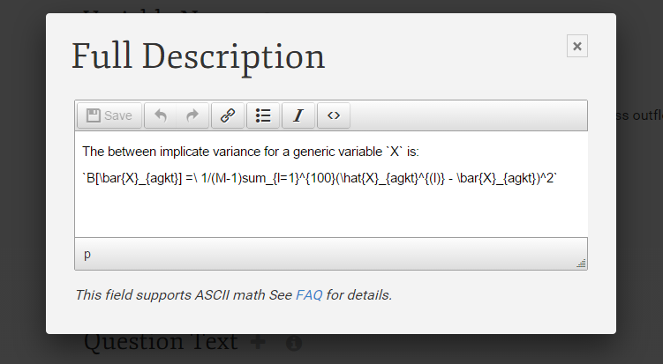
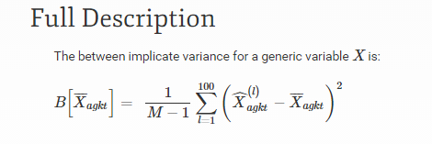
Editing
Allows for ASCII Math
Notes:
-We also can encode ASCII math – this is written in plain text without special characters
-Similar to latex
-Its also human readable in it’s decoded format
-The CED2AR frontend renders this nicely as formatted equations

Slide 13
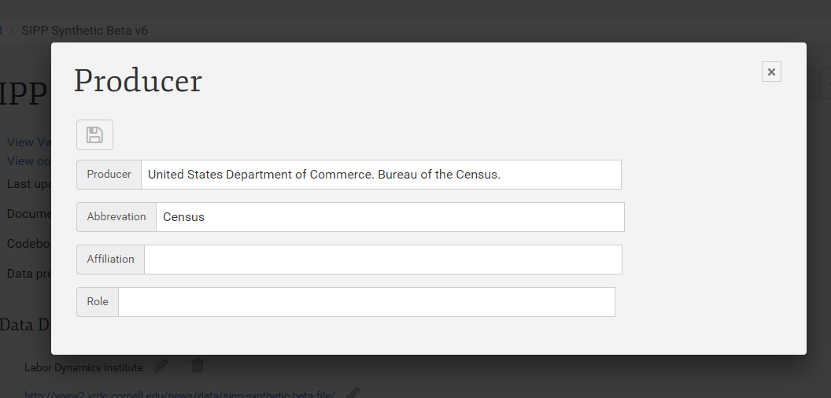
Editing
Growing support for additional DDI fields, exposed or not
Notes:
We add fields to DDI as users request them
-Easy to add to our profile

Slide 14
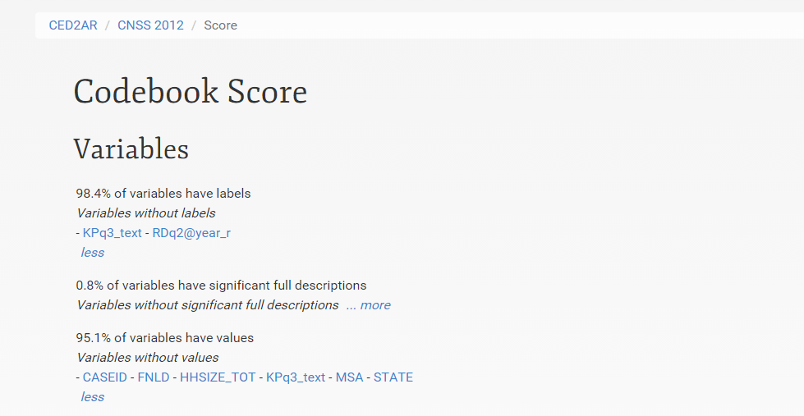
Metadata Scoring
Exposing sparse documentation
Notes:
-We use our DDI profile to determine the completeness of a particular codebook
-Each element is given a weighted to determine importance
-Users are guided to document missing metadata for elements

Slide 15
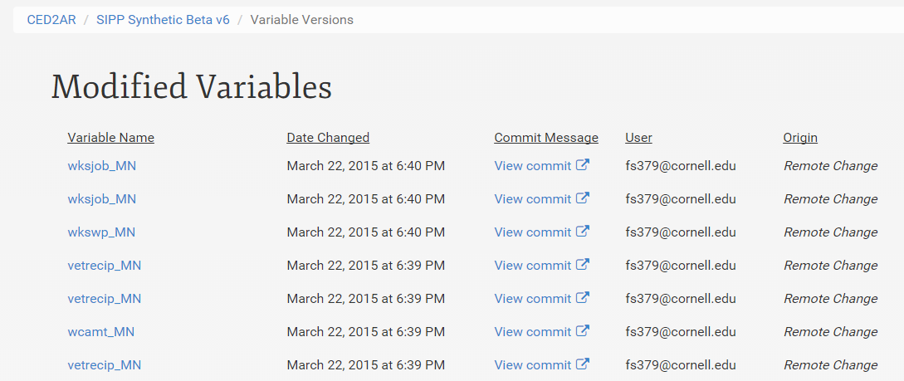
User Contributions

Slide 16
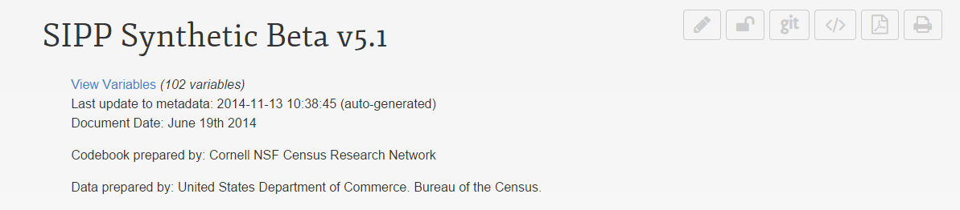
Versioning
Uses Git, a distributed version control system
Every aspect of the system is configurable
Scheduled tasks check for changes
Once changes exceed threshold, they are pushed
Pending changes are pushed after a time limit or on demand
Notes:
-Git is a distributed version control system
--Distributed meaning there is no central repository
-Git is scheduled to run in the background, regardless of the users’ actions
-Changes are documented within DDI

Slide 17
Architecture
Codebook 1.0
Master Branch (Official version)
1. User gets copy of DDI to edit
User Contributed Branch
Codebook 1.0
Notes:
User works off their own branch, or copy of the official codebook

Slide 18
Architecture
Codebook 1.0
Master Branch (Official version)
1. User gets copy of DDI to edit
User Contributed Branch
Codebook 1.0
Codebook 1.0 rev 1
Codebook 1.0 rev 2
…
Codebook 1.0 rev N
2. Each edit is versioned
Notes:
User make revisions to DDI
As they do so, the data owner can see these changes

Slide 19
Architecture
Codebook 1.0
Master Branch (Official version)
Codebook 1.1
1. User gets copy of DDI to edit
3. Data provider merges user’s edits back into official DDI
User Contributed Branch
Codebook 1.0
Codebook 1.0 rev 1
Codebook 1.0 rev 2
…
Codebook 1.0 rev N
2. Each edit is versioned
Notes:
At a certain point the data owner decides to merge any of the user’s changes back into the official version

Slide 20
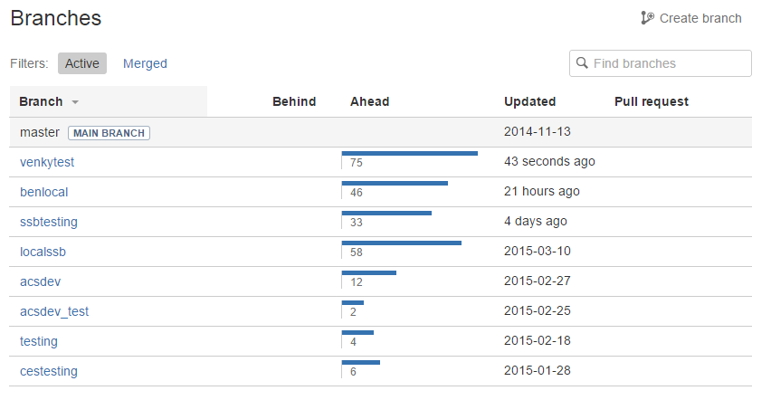
Architecture
Notes:
In reality, each network of CED2AR instances has more than two branches
A branch can track all the change on one server
Or all the changes on a single user’s desktop

Slide 21
Architecture
Server
Database
Web
Application
Local Repository
Remote
Repository
Notes:
Database only has valid DDI XML
Web application controls data flow
Access to the repository can vary, and can be manually changed or updated with ced2ar

Slide 22
Architecture
CED²AR Instance
Server
Remote
Repository
Notes:
Everything within a single server we refer to as an instance of ced2ar

Slide 23
Architecture
CED²AR Instance
Remote
Repository
CED²AR Instance
CED²AR Instance
CED²AR Instance
Notes:
-CED2AR is not a single website

Slide 24
Architecture
CED²AR Instance
Remote
Repository
CED²AR Instance
CED²AR Instance
(Official)
CED²AR Instance
CED²AR Instance
Notes:
Official copy describes authoritative copy can be found

Slide 25
Remote Location
Our implementation uses Bitbucket
Commit messages describe changes
Users linked by email address
Commit hashes are stored on CED²AR
Remote synchronization is optional
Notes:
-Changed synchronized with cloud based repository called BitBucket
-Changes are available to view or download online
-Each commit is a compilation of changes
--Within the commit message, user’s edits are referenceable by unique elements in DDI and their email address

Slide 26
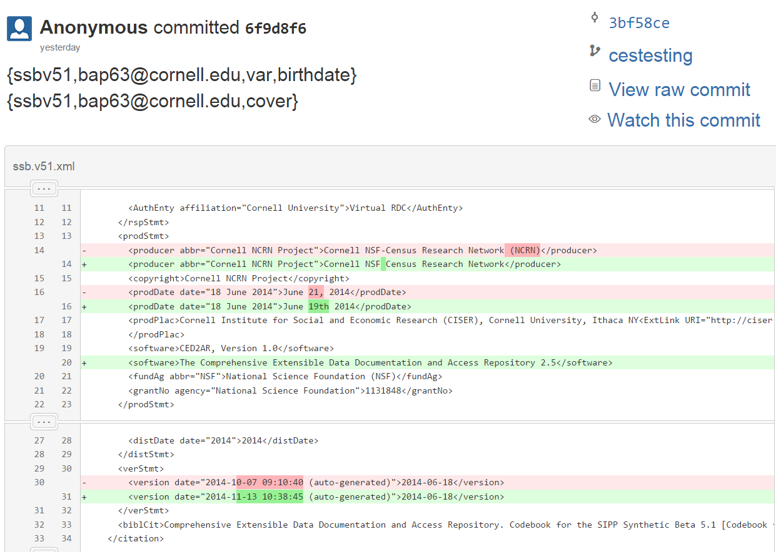
Remote Location
Notes:
Remote repository could be cloud based, local, or even offline
User has the possibility to disable remote pushes

Slide 27
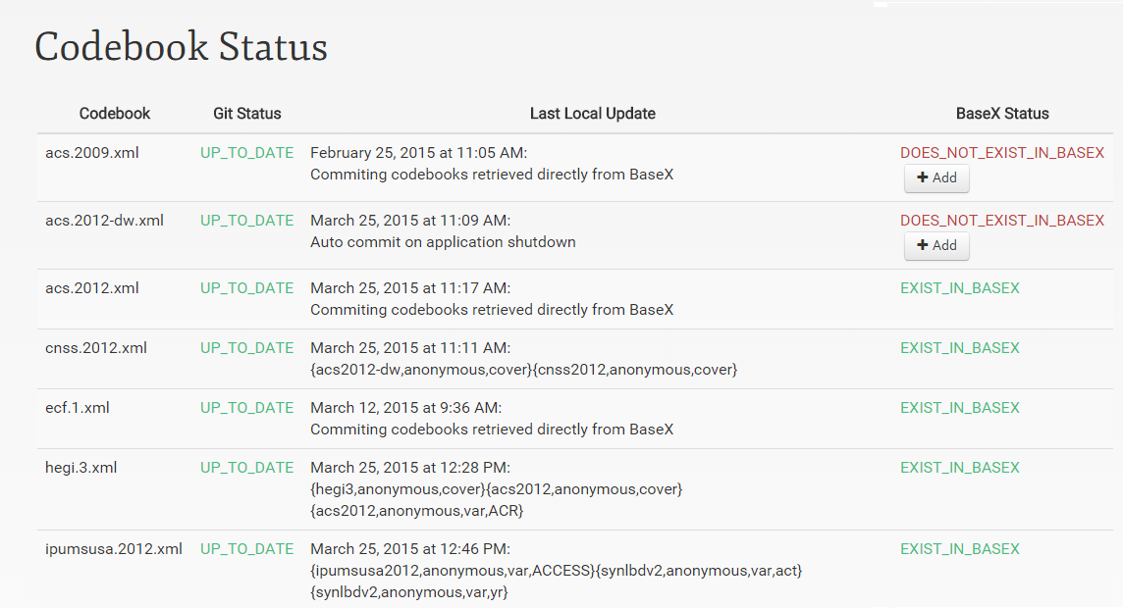
Tracking Changes
Notes:
Control to manage the flow of metadata This allows you to:
-Add codebooks from other instances
-Resolve conflicts
-Delete invalid codebooks
-Push or pull changes

Slide 28
Continued Work: Improving merge control
Codebook 1.0
Master Branch (Official version)
Codebook 1.1
1. User gets copy of DDI to edit
3. Data provider merges user’s edits back into official DDI
User Contributed Branch
Codebook 1.0
Codebook 1.0 rev 1
Codebook 1.0 rev 2
…
Codebook 1.0 rev N
2. Each edit is versioned

Slide 29
Continued Work: The uncontrolled merge
Workflow as described assumes metadata curator merges information
Within the limits of a 24-hour day: what’s the likelihood that that process scales?
Alternate: “wiki” methodology

Slide 30
Architecture (alternate)
Master Branch (Official version)
Codebook 1.0
Wiki Branch (Community version)
Codebook 1.0
Notes:
The data provider maintains the master branch of metadata, which is practically read only.
The from the master branch, a wiki branch, or community branch is contributed.

Slide 31
Architecture (alternate)
Master Branch (Official version)
Codebook 1.0
Wiki Branch (Community version)
Codebook 1.0
2
User Branches
Users pull from wiki branch into any instance of CED²AR
1
Notes:
As users edit on different platforms they

Slide 32
Architecture (alternate)
Master Branch (Official version)
Codebook 1.0
Wiki Branch (Community version)
Codebook 1.0
Codebook rev 1
2
User Branches
Users push back to branch manually
1

Slide 33
Architecture (alternate)
Master Branch (Official version)
Codebook 1.0
Wiki Branch (Community version)
Codebook 1.0
Codebook rev 1
2
User Branches
3
1
New users work off most recent revision by default

Slide 34
Architecture (alternate)
Master Branch (Official version)
Codebook 1.0
Wiki Branch (Community version)
Codebook 1.0
Codebook rev 1
…
Codebook rev X
2
User Branches
3
1

Slide 35
Architecture (alternate)
Master Branch (Official version)
Codebook 1.0
Wiki Branch (Community version)
Codebook 1.0
Codebook rev 1
…
Codebook rev X
2
User Branches
3
1

Slide 36
Architecture (alternate)
Master Branch (Official version)
Codebook 1.0
Wiki Branch (Community version)
Codebook 1.0
Codebook rev 1
…
Codebook rev X
2
User Branches
User is responsible for merging
3
1

Slide 37
Architecture (alternate)
Master Branch (Official version)
Wiki Branch (Crowdsource version)
Codebook 1.0
Codebook rev X
CED²AR User Interface exposes both versions
(with attribution)

Slide 38
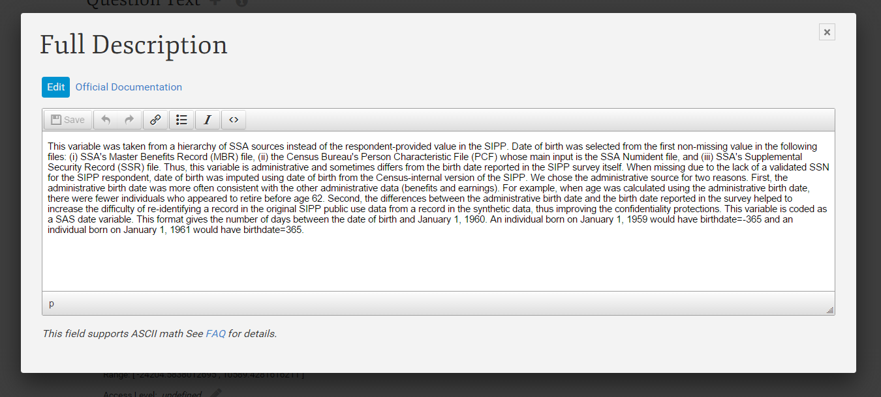
Continued Work: Improving merge control
Merging crowd-sourced content back into official documentation

Slide 39
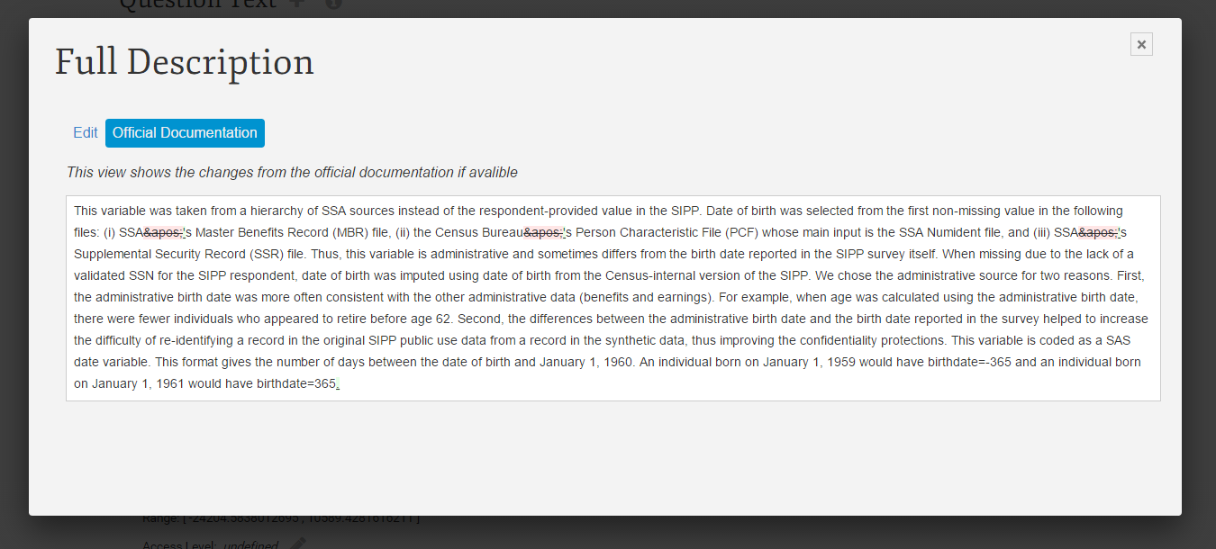
Continued Work: Improving merge control
Merging crowd-sourced content back into official documentation

Slide 40
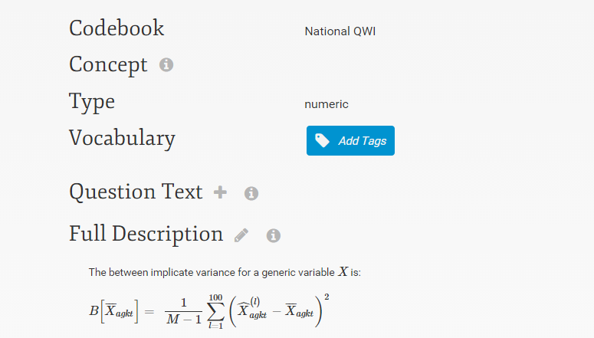
Continued Work: Facilitating Editing
Tagging variables with a controlled vocabulary and a folksonomy

Slide 41
Thank you!
Questions?
bap63@cornell.edu
ncrn.cornell.edu
github.com/ncrncornell

